Slide 1

By Ashish Chandra Sarkar

Slide 2
Customer Churn
Customer churn refers to the phenomenon when a customer leaves a company or an organization, in our case a bank. Some studies shows that acquiring new customers can cost 5 times than that of satisfying and retaining existing customers. Thus tracking of bank customer churn rate through prediction will help in reducing marketing costs, lead to increase in capital ,expanding total customers and a lot more.
In this project, I have done an Exploratory Data Analysis(EDA) and churn prediction through machine learning techniques on the bank customers dataset which is taken from Kaggle

Slide 3
Causes of Customer Churn:
Companies generally end up diverting resources from the customers with Success Potential who could actually benefit from their attention to those that, regardless of effort, will not be successful.
Customers aren’t achieving their desired outcomes. Banks promise various amenities to attract customers but due to hidden policies a lot of customers get frustrated and this leads to churn of such customers.
Customer support needs work: Customer support is a major part in customer satisfaction as customers face a lot of problems in the overall process and an incompetent network can cause extensive amount of dissatisfactions

Slide 4
Customers think your competitors can do a better job: Due to competition various competitors offer deals which are much better on paper and that attracts a customer
Product has bugs customers believe you can’t fix: If a bank can’t fix the problems with the products within a stipulated time that leads to dissatisfaction and leads to a customer believing that the bank is incapable of fixing such issues.
Customers no longer see the value in the product: With time customers need change and the type of products also evolve with the market and due to this a customer may loose the interest in the product because they don’t believe in the value of the product anymore.

Slide 5
Process Approach:
Collection of Data
Data Pre-Processing
Exploratory Data Analysis
Data Visualisation
Result
Binary Classification
Predictive Analysis

Slide 6

Methods and Techniques Involved:
Collection Of Data:
The data has been collected from Kaggle. The data has 13 columns with 10k rows.
Data Pre-Processing:
Data preprocessing is a data mining technique that involves transforming raw data into an understandable format. In this method we get to know our data in a better way.
Exploratory Data Analysis:
In EDA, we generally transform our data to be ready for ML models.(for example:- Remove NULL values, converting categorical to numerical etc.)
Predictive Analysis:
Predictive analytics is the use for statistics and machine learning techniques to predict about the future (unknown data). The goal is to predict the probable future through past experience. Similarly in our analysis, predictive analysis has been done by implementing time series forecasting.
Binary Classification:
Binary classification is used for analyzing data in order to study the behavior of data with respect to a decision of ‘yes’ or ‘no’ . This method involves the use of a model to predict values in reference of previously observed instances and patterns.

Slide 7
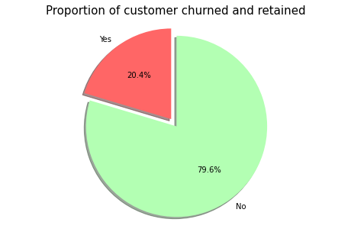
Outcomes During EDA:
We started with a imbalanced dataset as the percentage of yes or no classes in the Exited column was quite considerate.
We had 20.4% entries that churned and 79.6% entries were customers who did not churn with time.
By this we decided that we need to go with metrics which will give more importance to the class that has less percentage so the metrices selected were :
Recall
Precision
F1-Score

Slide 8
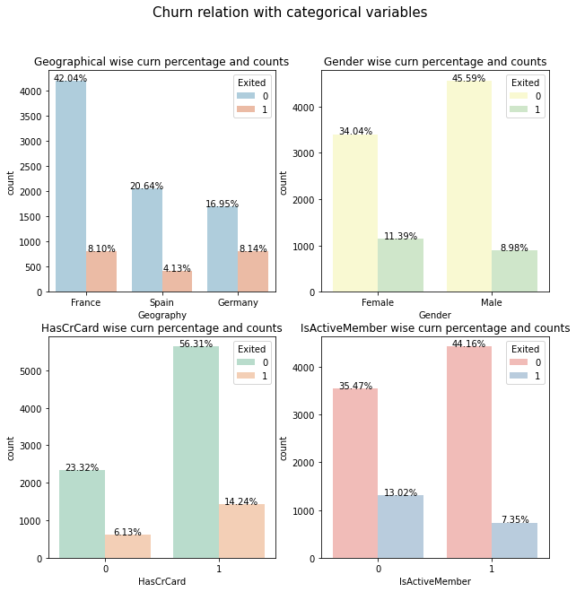
Categorical Variables:
Majority of the data is from persons from France.
However, the proportion of churned customers is with inversely related to the population of customers coming to the bank possibly having a problem (maybe not enough customer service resources allocated) in the areas where it has fewer clients.
The proportion of female customers churning is also greater than that of male customers Interestingly, majority of the customers that churned are those with credit cards. Given that majority of the customers have credit cards could prove this to be just a coincidence.
Unsurprisingly the inactive members have a greater churn. Worryingly is that the overall proportion of inactive members is quite high suggesting that the bank may need a program implemented to turn this group to active customers as this will definitely have a positive impact on the customer churn.

Slide 9
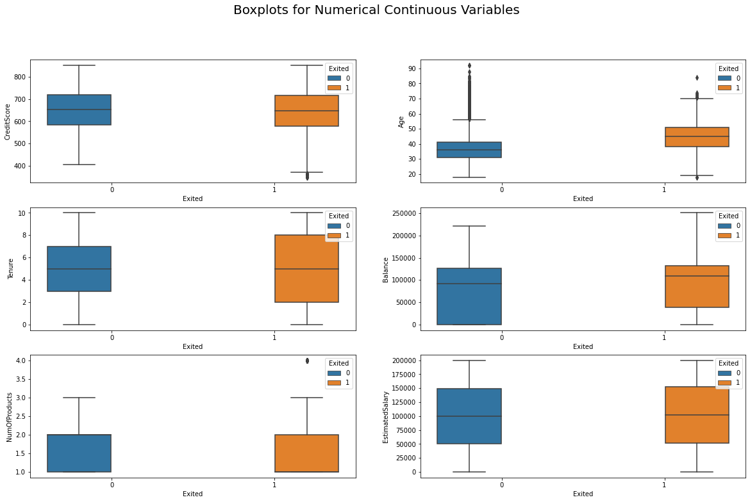
Continuous Numerical Variables:
There is no significant difference in the credit score distribution between retained and churned customers.
The older customers are churning at more than the younger ones alluding to a difference in service preference in the age categories. The bank may need to review their target market or review the strategy for retention between the different age groups
With regard to the tenure, the clients on either extreme end (spent little time with the bank or a lot of time with the bank) are more likely to churn compared to those that are of average tenure.
Worryingly, the bank is losing customers with significant bank balances which is likely to hit their available capital for lending.
Neither the product nor the salary has a significant effect on the likelihood to churn.

Slide 10
Feature engineering:
I created three new features which helped us bring out more inference from the data.
BalanceSalaryRatio
TenureByAge
CreditScoreGivenAge

Slide 11
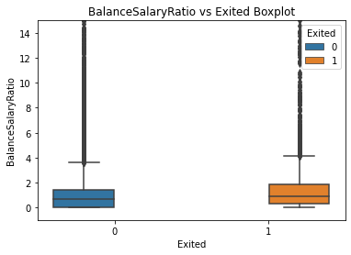
BalanceSalaryRatio:
We already observed that the salary has little effect on the chance of a customer churning. However as seen above, the ratio of the bank balance and the estimated salary indicates that customers with a higher balance salary ratio churn more which would be worrying to the bank as this impacts their source of loan capital.

Slide 12
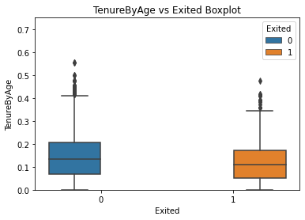
TenureByAge:
The data did not show much variation but we can see that customers churned have stayed for lesser than 2 months majorly so the bank needs to look into clients who churn out after 2 months

Slide 13
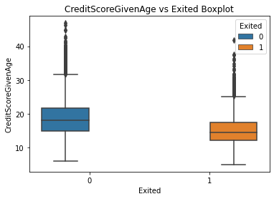
CreditScoreGivenAge:
Inference- From here we can see that the customers which churned out have lesser CreditScoreGivenAge and this may be due to customers bad relationship with the bank or payment irregularities or because of customers dissatisfaction

Slide 14
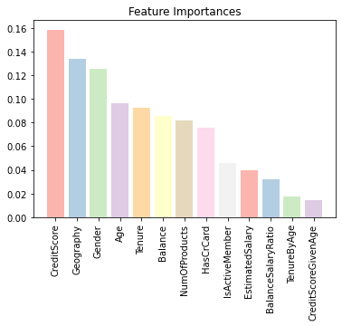
Feature Importance:
We Chose to select all the variables the features show consideration feature importance and none of them had poor importance.

Slide 15
Model Selection:
For Model fitting, we tried a couple of different machine learning algorithms in order to get an idea about which machine learning algorithm performs better . Since this was a binary classification problem and further it had an imbalance in the data, hence we tried the following algorithms :
1. Logistic Regression
2. Logistic Regression with degree 2 polynomial kernel
3. SVM with Rbf kernel and poly kernel
4. Random Forest Classifier¶
5. Extreme Gradient Boosting Classifier

Slide 16
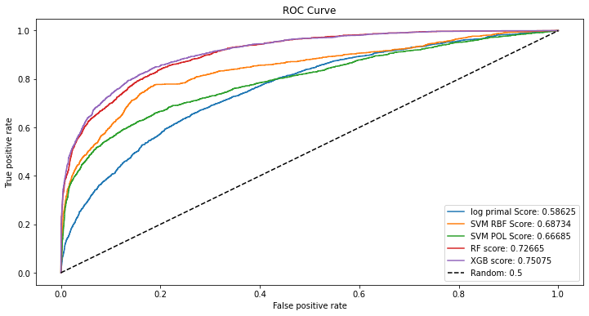
Metrices:
[
XG-Boost gave us the best result with:
Training data accuracy of 85%
Test data accuracy of 82%
As the data had imbalance to handle the situation we used SMOTE oversampling and after that the model gave us the accuracy of:
Training data accuracy of 89%
Test data accuracy of 87%
After Over sampling there was still certain amount of overfitting hence I applied RFE and with that the features selected were:
'Geography', 'Gender', 'Age', 'Tenure', 'NumOfProducts', 'IsActiveMember’
Training data accuracy of 93%
Test data accuracy of 90%
So finally We selected XGB After oversampling for the better performance.

Slide 17
Summary:
Customer churn is a huge problem for any industry as for a successful business, there is a need of a loyal customer base which gives the business the ability to grow and get a substantial hold in the market.
By this project we aim to give the ability to predict that a particular customer is at a high risk of churning, while there is still time to do something about it, represents a huge additional potential revenue source for every online business. Besides the direct loss of revenue that results from a customer abandoning the business, the costs of initially acquiring that customer may not have already been covered by the customer’s spending to date. (In other words, acquiring that customer may have actually been a losing investment.) Furthermore, it is always more difficult and expensive to acquire a new customer than it is to retain a current paying customer.
We aim to make a change by helping the business by this model as well as make a difference for the society.

Slide 18

Thank You
By: Ashish Chandra Sarkar
Notes:
In Slide Show mode, click the arrow to enter the PowerPoint Getting Started Center.

